Slide 1
SMART ATTENDANCE MANAGEMENT SYSTEM

Slide 2







MEET THE TEAM
Varnika Prasad
Sai Divya G
Sri Kiran Pramoda R
Sravya K
Sai Krishna G

Slide 3


OUR APPLICATION
Our goal is to create an AWS-based attendance management system for educational institutions that enhances the process of tracking and managing attendance, resulting in improved efficiency and accuracy.
This system can be adapted to meet the specific needs of various institutions around the world.
Additionally, by incorporating various features, our application can be utilized by different industries, including corporate organizations, healthcare facilities, government offices, and various events.

Slide 4










Why AWS?
Globally available Can be deployed across multiple regions
Scalability
Can easily scale up or scale down the resources based on applications demand
Security
AWS security features enables to build a secure and compliant applications
Flexibility
Provides wide range of applications and services which helps us to choose the best based on our requirement
Cost Effective
Pay as you go model enables to pay only for the resources you uset

Slide 5

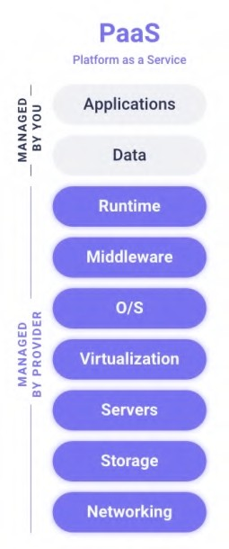

Functional Requirements :
Create and Manage User accounts.
Real-time monitoring of attendance data is achieved through the use of dashboards and reports. Notifications and email updates are provided, and customized reports are generated for faculty and staff, reducing manual work.
The system enables user authentication and location tracking and can be integrated with other management systems.
The system has the ability to identify trends and patterns of the student's attendance for a particular class.

Slide 6

Non-Functional Requirements :
High Data Storage
Data Archiving which ensures compliance and regulatory requirements
Cost effective solution
Easy to use and navigate
Scalability
Highly available and reliable solution
Faster response time

Slide 7
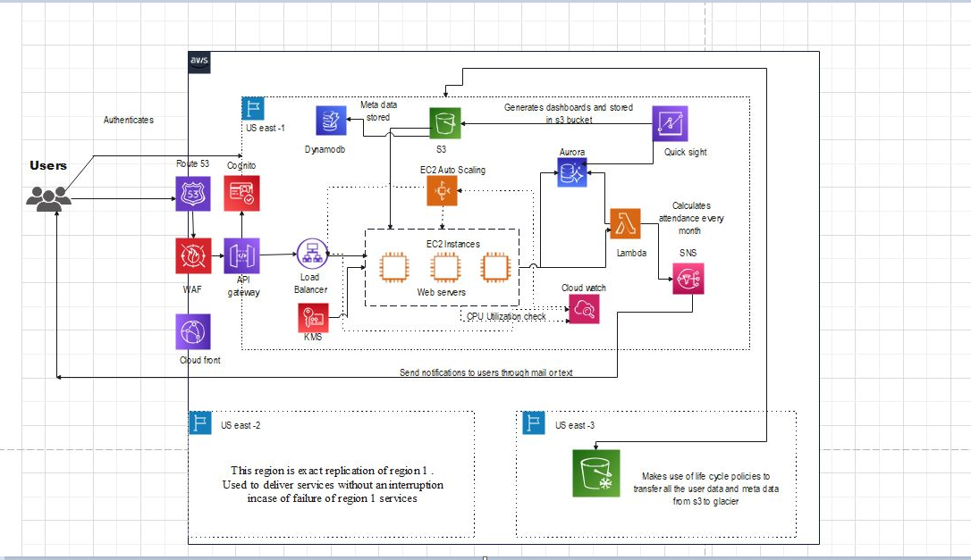
Architectural Diagram

Slide 8











Operational Excellence
Security
Reliability
Performance Efficiency
Cost Optimization
Sustainability

Slide 9

Operational Excellence
This pillar focuses on the ability to run and monitor systems to deliver business value and to continually improve supporting processes and procedures. For an attendance management system, operational excellence could be achieved using automated monitoring and alerting systems to ensure system uptime and availability.
Services used in this project for Operational excellence are:
Operate/Evolve/Responses:
AWS CloudWatch & CloudWatch Dashboard

Slide 10
Security
Security should be a top priority when implementing cloud-based attendance management. Make sure that data is encrypted, access is restricted based on user roles, and that the cloud provider has adequate security measures in place to protect against data breaches.
Services used in this project for Security are:
Data Protection
Infrastructure Protection
Detective Controls
Incident Response
AWS KMS
AWS WAF
AWS CloudWatch
AWS SNS

Slide 11

Reliability
Attendance management is critical for organizations, and downtime can be costly. Make sure that the cloud provider has a reliable infrastructure with minimal downtime, and that there are backup and disaster recovery plans in place to ensure continuity of service.
Services used in this project for Reliability are:
Change Management
Failure Management
AWS CloudWatch & AWS Auto Scaling
Amazon Route 53

Slide 12
Performance Efficiency
A cloud-based attendance management system should be easy to use and intuitive for
both administrators and employees. The system should have a user-friendly interface, be accessible from multiple devices, and support integration with other systems used by the organization.
Services used in this project for Performance Efficiency are:
Monitoring Trade Offs
Cloud watch, Lambda, AWS SNS CloudFront
Selection
AWS S3, S3 Glacier, DynamoDB

Slide 13

Cost Optimization
Cloud-based attendance management can help reduce costs associated with manual attendance tracking and increase productivity by automating attendance management tasks. This cloud- based attendance management system is designed to be cost-effective and provide a good return on investment for organization.
Services used in this project for Cost Optimization are:
Match Supply and Demand
Expenditure Awareness
Auto Scaling
CloudWatch

Slide 14
Sustainability
Cloud-based attendance management is a daily used service which should be designed sustainable. A design with low carbon emission, minimal budget to use the same architecture for long run, scalable so that it need not be changes every time.
Services used in this project for Auto Scaling are:-
Environmental Sustainability Social Sustainability Auto Scaling, AWS Load balancers Cloud Watch, AWS Lambda
Economic sustainability
S3 Glacier, Lamda

Slide 15


